Slide 1

RAM MANDIR
AYODHYA

Slide 2
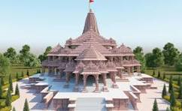
The Ram Mandir ( 'Rama Temple') is a Hindu temple complex in Ayodhya, Uttar Pradesh, India. We Indians believe that it is located at the site of Ram Janmabhoomi, the mythical birthplace of Rama, a principal deity of Hinduism.
According To The Shri Ram Janmabhoomi Teerth Kshetra, The Temple Has Been Constructed In The Traditional Nagar Style. It Has A Length (East-west) Of 380 Feet, A Width Of 250 Feet, And A Height Of 161 Feet. The Trust Said That The Temple Is Three-storied, With Each Floor Being 20 Feet Tall.

Slide 3
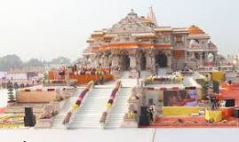
Ayodhya was stated to be the capital of the ancient Kosala kingdom in the Ramayana. Hence it was also referred to as "Kosala". The Adi Purana states that Ayodhya is famous as su-kośala "because of its prosperity and good skill". The cities of Ayutthaya (Thailand), and Yogyakarta (Indonesia), are named after Ayodhya.

Slide 4
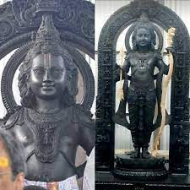
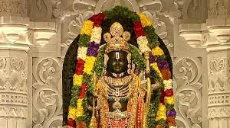
In 1528, the commander of the Mughal Empire, Mir Baqi, constructed the Babri Masjid mosque, under the order of Babur, on the site of the Ram Janmabhoomi, the birthplace of Lord Shri Rama
The site is significant to Hindus as it is known to be the birthplace of revered deity Rama. Balak Ram or the Infant form of Rama is the presiding deity of the temple consecrated on 22 January 2024.

Slide 5
1853: A Hindu sector claims that a temple was destroyed during Babur’s reign to make way for the mosque, which was the first recorded instance of conflict. 1859: The British colonial administration partitions the site into two separate sections for Hindus and Muslims. Muslims allowed to pray inside, while Hindus allowed to worship in the outer courtyard and thus the British erected a fence. 1949: Devotees of Rama placed idols dedicated to him in the mosque, and the structure was subsequently declared off-limits to Muslims. The Babri Masjid was destroyed during a political rally on 6 December 1992, triggering riots all over the Indian subcontinent.
1961: Mohammad Hashim filed a suit pleading for restoration of the property to Muslims. The Sunni Central Wakf Board filed a suit in Faizabad civil court declaring Babri Mosque as property of the board.
1984: The Vishwa Hindu Parishad spearheads a movement to 'liberate' the birthplace of Lord Ram and build a temple.

Slide 6
1989: The Vishwa Hindu Parishad (VHP) laid the foundations of a Ram temple on land adjacent to the disputed mosque. Four suits that were pending at the Faizabad court were transferred to a special bench of the High Court.
1998: The BJP formed the coalition government under Prime Minister Atal Behari Vajpayee. 2001: Tensions rose on the anniversary of the demolition of the mosque. VHP pledged again to build a Hindu temple at the site. Vajpayee set up an Ayodhya cell in his office and appointed a senior official, Shatrughna Singh, to hold talks with Hindu and Muslim leaders.
2003: The survey said there is evidence of a temple beneath the mosque, but Muslims disputed the findings.
2011: All three parties in the case: Nirmohi Akhara, Ram Lalla Virajman and Sunni Waqf Board appealed against the Allahabad High Court verdict. The Supreme Court upheld the HC order of splitting the disputed site into 3 parts.

Slide 7
2019: In November 2019, a five-judge bench of the Supreme Court ordered the disputed land to be handed over to a trust to build the Ram Janmabhoomi temple. The court also ordered the government to allocate five acres of land in another place to the Sunni Waqf Board to build a mosque. 2020 Foundation Stone Laying Ceremony: On August 5, the foundation stone for the construction of Ram Temple was laid by Prime Minister Narendra Modi. He performed Bhoomi Poojan and laid the foundation stone of the grand Ram temple. Modi became the first Prime Minister to have Darshan at Ram Janmbhoomi and Hanumangarhi temple of Ayodhya. May 2022: Shri Ram Janmbhoomi Teerth Kshetra informed that the construction of the Ram Mandir in Ayodhya is in full swing. According to the report, the foundation has been laid, and the plinth or the pedestal raising work, began in January.
January 2024: Shri Ram Janambhoomi Trust Champat Rai has confirmed that the idol of Lord Ram will be installed at the temple on January 22, 2024, and PM Modi will attend the inauguration. The Vishva Hindu Parishad has said it will invite more than 10 crore families in the country and abroad to take part in the consecration ceremony to be held at Ram temple in Ayodhya on January 22. January 22, 2024: Ram Mandir 'pran pratishtha' or consecration ceremony took place.

Slide 8
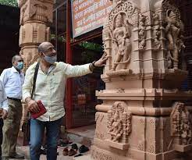
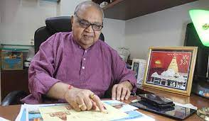
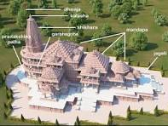
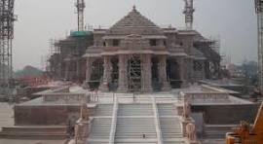
Construction of Ram Mandir
Significance of Temple’s Architecture In Hindu Tradition:
The form and meanings of architectural elements in a Hindu temple are designed to function as the place where it is the link between man and the divine, to help his progress to spiritual knowledge and truth, his liberation it calls moksha. A Hindu temple reflects a synthesis of arts, the ideals of dharma, beliefs, values and the way of life cherished under Hinduism. It is a link between man, deities, and the Universal Puruṣa in a sacred space.
Architectural Design And Features:
The Ram Mandir, which is being supervised by the Shri Ram Janmabhoomi Teerth Kshetra Trust, is designed in the Nagara style(a prominent tradition in North Indian temple architecture) of architecture by Chandrakant Sompura and his son Ashish Sompura. the temple boasts curvilinear towers (shikharas), a front hall (mandapa), a sanctum (garbhagriha), and intricate carvings. Considered an architectural masterpiece, it reflects traditional Indian heritage.

Slide 9
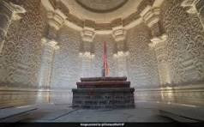
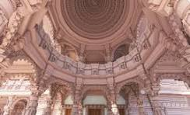
According to Hindu mythology, Lord Rama was born in Ayodhya to King Dasharatha and Queen Kaushalya. The epic begins with the divine birth of Rama and his three brothers, Bharata, Lakshmana, and Shatrughna. The early years of Rama's life are marked by his marriage to Sita, an incarnation of the goddess Lakshmi.
At the heart of the temple's significance lies the belief that it stands on the spot where Lord Rama, the seventh avatar of Lord Vishnu, was born. The Ayodhya Ram Mandir becomes not just a structure but a sacred ground, revered by devotees who see it as a living connection to our beloved deity.

Slide 10
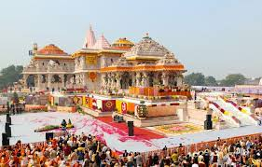
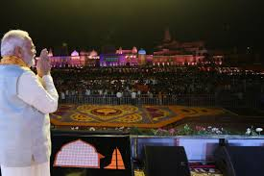
Political And Legal Dimensions
The construction of the Ram Mandir in Ayodhya, India has political and legal implications, and is a significant milestone for Hindu nationalist political entities.
The temple's construction, consecration, and promotion are government projects, and the event was marked by a half-day holiday for central government offices.
Some say that the temple's construction is a carefully cultivated display of religious pride for political gain, and that the Ram temple movement has benefited the BJP's political fortunes.
The temple's legal implications include a title suit that determined who has possession rights over the disputed land. The Supreme Court's 2019 verdict cleared the way for the construction of the temple, and put an elected government in charge of the project instead of a religious organization.

Slide 11
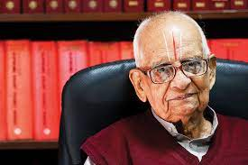
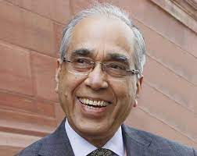
Various stakeholders involved in this dispute include the Indian government, the Supreme Court of India, Hindu nationalist groups, Muslim groups, and local residents. The Indian government had played a key role in the dispute, with Prime Minister Narendra Modi pledging to build the temple if elected in 2014. The Supreme Court had also issued several orders and judgments related to the dispute, including a 2019 decision that allowed the construction of the temple to begin.
Advocate K Parasaran (founder Trustee), a prominent Supreme Court lawyer who also served as a former Attorney General of India, successfully fought the Ayodhya land dispute case for the Hindu parties, furthermore, he has been named as a trustee in the Shri Ram Janmabhoomi Teerth Kshetra.
Former IAS officer and Principal Secretary, Nripendra Mishra was nominated as the Chairman of the construction committee. Currently, Swami Govind Dev Giri Ji Maharaj is the Treasurer and K. Parasaran is the Senior Spokesperson of the trust.

Slide 12
CULTURAL IMPACT:
The inauguration of the Ram Mandir marks a historic milestone in Indian history, symbolizing the triumph of faith, unity, and justice. The construction of the temple not only fulfills the aspirations of millions of Hindus but also embodies the secular ethos and pluralistic values of India.
The temple is a symbol of faith and devotion for Hindus, and represents a dedication to their beliefs in the face of historical turbulence. It also symbolizes national unity, transcending religious and regional divides, and is a testament to India's inclusive culture.
The temple's construction has brought people from different backgrounds together in a spirit of harmony and brotherhood. It has also accumulated a large amount of donations for its construction and development.
The temple is a major pilgrimage site that will boost tourism in the city, benefiting local traders, hotels, and motels.

Slide 13
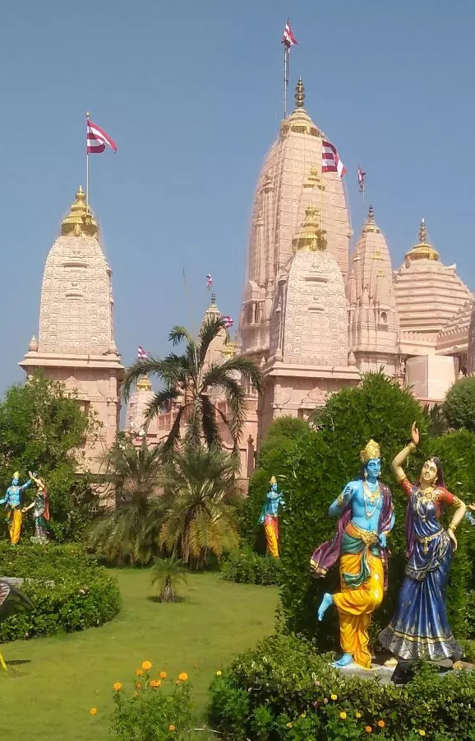
The temple's inauguration has lead to a revival of Hindu traditions, arts, and practices. The temple's story, from its controversial past to its recent inauguration, is now part of India's collective consciousness, influencing how society responds to future communal challenges.
The temple serves as a reminder of the importance of upholding the values of unity, tolerance, and diversity in the country.
Tourism has contributed to the economic growth of Ayodhya and Uttar Pradesh, India, generating over 20,000 jobs and an estimated ₹4 lakh crore in tourism-related spending in 2022. In 2022, Ayodhya attracted 2.21 crore tourists, with domestic tourists spending nearly ₹2.2 lakh crore and foreign visitors contributing an additional ₹10,000 crore. The Uttar Pradesh government could also generate over ₹25,000 crore in tax revenue from Ayodhya. Tourism sector is expected to generate a revenue of 59 billion by 2028, creating 140 million temporary & permanent jobs by 2030.

Slide 14
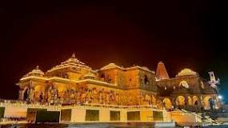
Ayodhya's tourism is improving with a new airport, expanded railway station, and a planned greenfield township. This development is set to boost various sectors, including hotels, airlines, hospitality, FMCG, travel, and cement, benefiting the economy.
The local economy of Ayodhya has got a huge boost two months after the opening of the Ram Temple. Businesses have reported a three to four-times increase in their incomes with lakhs of tourists visiting the temple.
Estimates suggest Ayodhya could attract over 5 crore tourists annually, a significant increase from pre-Mandir figures. This surge is expected to be fueled by both domestic and international pilgrims drawn by the temple's religious significance and architectural grandeur.
The Tourist attraction of Ayodhya comprises of old historical buildings, the museums, the temples, the gardens that adds to the beauty of the city.
The government has estimated Ayodhya to generate Rs 55,000 crore annually in tourism revenue alone during initial years. “It is estimated that on an average, a tourist would spend Rs 2,000 in Ayodhya.

Slide 15
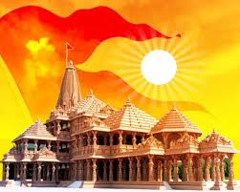
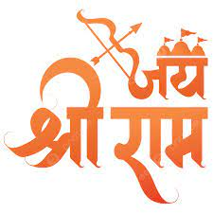
The Shree Ram Mandir in Ayodhya, India is a symbol of faith, cultural heritage, and national unity, transcending religious and regional divides. It stands as a testament to the inclusivity of Indian culture, where diversity is celebrated and unity is forged through shared values and beliefs. It's also a reflection of Hindus' collective consciousness and a reminder that cultural heritage evolves over time. The temple's construction has been a journey of faith, and its inauguration is a cultural milestone that could lead to a revival of Hindu traditions, arts, and practices.
The significance of the Ram Mandir in contemporary India lies in the political and religious context of the country. It is seen as a symbol of India's Hindu identity, and its construction has been a major issue in Indian politics for decades.
THANK YOU
JAI SHREE RAM

